Slide 1
Web developement

Slide 2
Web introduction
Internet : a massive network that connect million of people togather globally
Protocols : a set of rules that allows informations to travel over the Internet
The WEB : it’s a way of accessing informations over the internet : information sharing model on top of the internet
Web architechture: interaction between two types of systems (client and server ) linked togather by an ISP : internet server provider
API : an intermadiary software that allows an application to communicate to each other

Slide 3
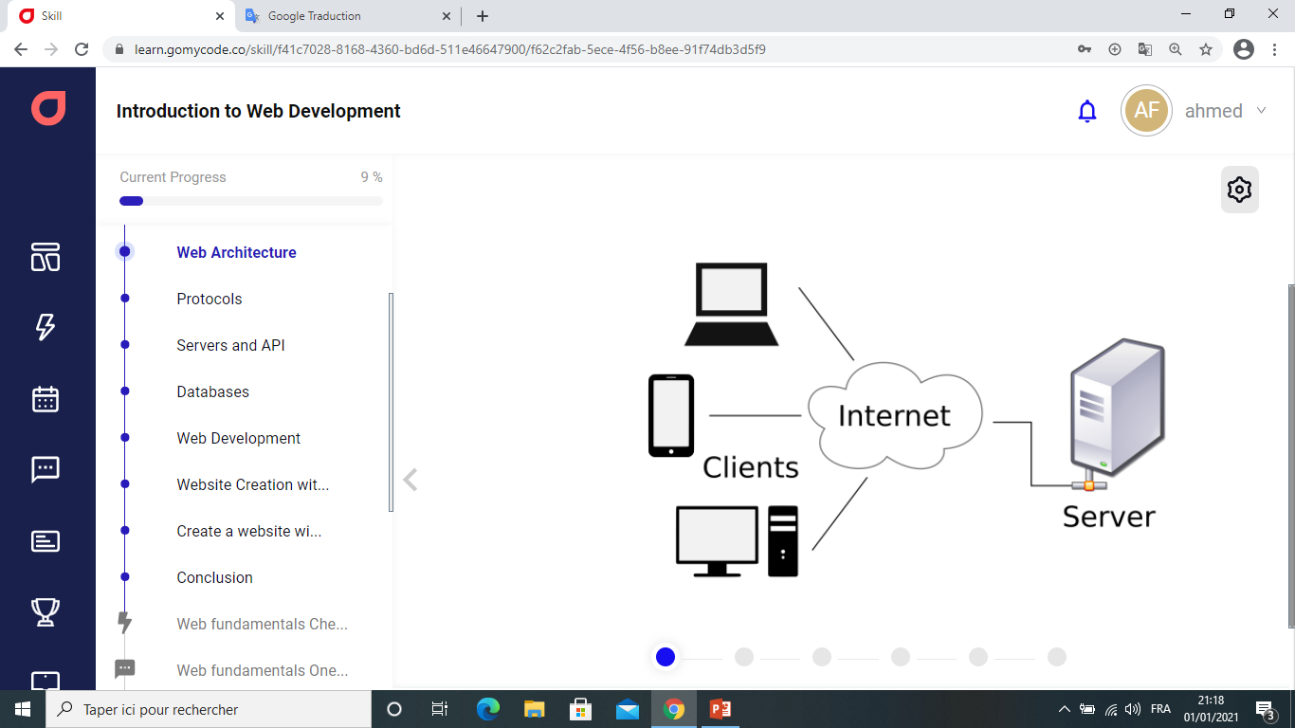
A server contains files of specific wesites each one identified by a specific identifier called IP adress
server
files
Web sites identified by IP ADRESS

Slide 4
NETWORK Protocols : are THE rules and standards that gouvern how a device communicates on a network
http protocol
Tcp/ip protocol
Dhcp protocol
Rules and standards that gouvern the request send by the browser (client) and the respond given by the web server among the same connected computer
Basic instructions of transferring packets between two connected computer (IP PROTOCOL)
The ordering of the transmitted packets (TCP PROTOCOL)
Assigning a unique IP to each device connected to a networck

Slide 5
Databases: a systematic collection of data used to support its storage and its manipulationand make management data easy
SQL DATABASES (structured query database)
Allows communication with database in order to manage its content
Relational structured query langage
Vertically scalable and table based
Are better for multirow transactions
NO SQL DATABASES
Are not relational
Have dynamic shemas for unstructured data
Horizontally scalable
Are
better for unstructured data

Slide 6
Web development
Web developement is a process of building (coding and programming) websites and applications for the internet or for a private network as intranet,
Web developement can be broken into 3 llayers :- client side coding (frontend)
- Cerver side coding (backend)
- database technology
Web developer : a creative artist who use the basic building blocks of the web (HTML, CSS, and Javascript) to creat something complex like webpages,

Slide 7
Skills required to be a web developer
The three pillares of the web are :
-HTML : defining the content to be displayed
-CSS : telling the browser how to display the content
-JavaScript : how to make the content interactive
To create a web sites , a web developer need a CMS ( content management System) and the Hard coding part
CMS examples : Wordpress , Joola , Drupal and Prestashop

Slide 8
to create a web site we need :
Visual Studio Code
Git and Github
Google Chrome
A text editor to write a code
A web browser to see what we are building

